Slide 1
Precipitation Nowcasting and Classification through Deep Transfer Learning
Presentation
B22ACT01
PREETHI G - S20190020241
SHRI TEJA K - S20190020223
MENTOR - ANISH CHAND TURLAPATHY

Slide 2
Outline
Work Done
Visualization and Data Labeling
Block Diagram
Base CNN Result
Rainfall Detection
Dynamic Visualization
Model Summary
Result
Evaluation
References

Slide 3
Work Done
Mid Evaluation
End Evaluation
A demonstration of the base CNN model and supplementary classification result.
A demonstration of the CNN-FT model and CNN-GRU model.

Slide 4
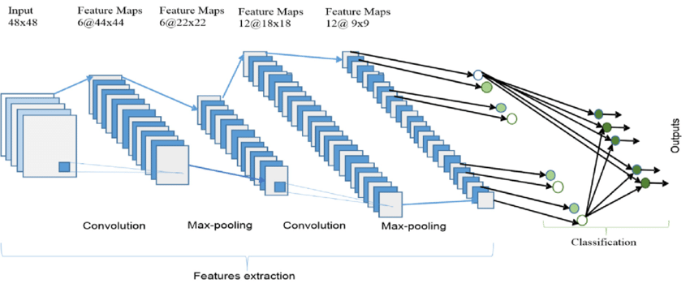
Abstract
Deep learning based models require a prerequisite data for training .
Gained knowledge from these can be useful for similar scenarios.
Deep learning will help in improved Precipitation Nowcasting model.
Models built:
Base CNN nowcasting model
CNN - Fine Tuning
CNN - MMD

Slide 5

Data Set Description
Name of the dataset: NOAA NEXRAD(level II)
File Format: ar2v files
Input : Miami, Florida, USA and a small amount of data from New Orleans, Louisiana, USA
Output Location : New Orleans, Louisiana city, USA
Data Source Link : https://github.com/awslabs/open-data-docs/tree/main/docs/noaa/noaa-nexrad
Dataset needs to labeled as “0” or “1”
The labelling is done with a threshold in radar reflectivity (taken to be 35 dBZ)
trained classifier can be used for predictions on new radar data
1 - yes, Rainfall ; 0 - No Rainfall

Slide 6
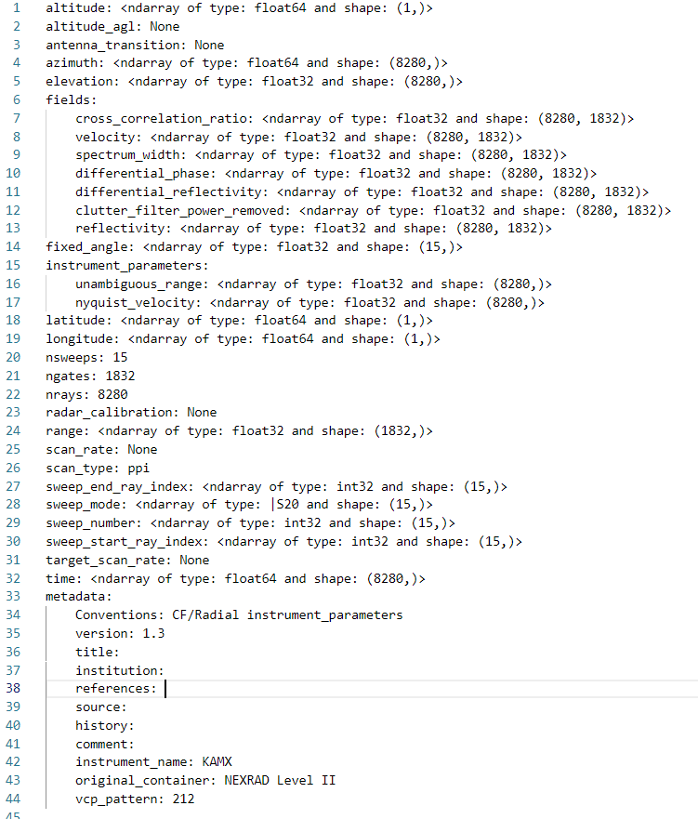
Data Retrieval and Data Fields
Accessing NEXRAD (Level II) Archive data
Hosted in Amazon S3 bucket (us-east-1) AWS
Basic format : /<Year>/<Month>/<Day>/<NEXRAD Station/>/<filename>
File name Format : GGGGYYYYMMDD_TTTTTT_V06

Slide 7
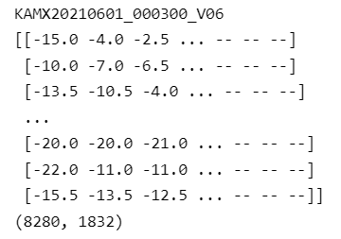
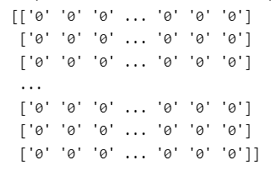
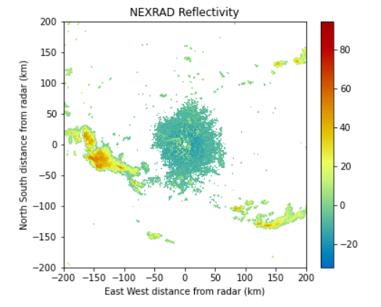
Visualization
Data Labeling
Reflectivity Threshold - 35 dBz
35 dBz above – 1
35 dBz below – 0

Slide 8
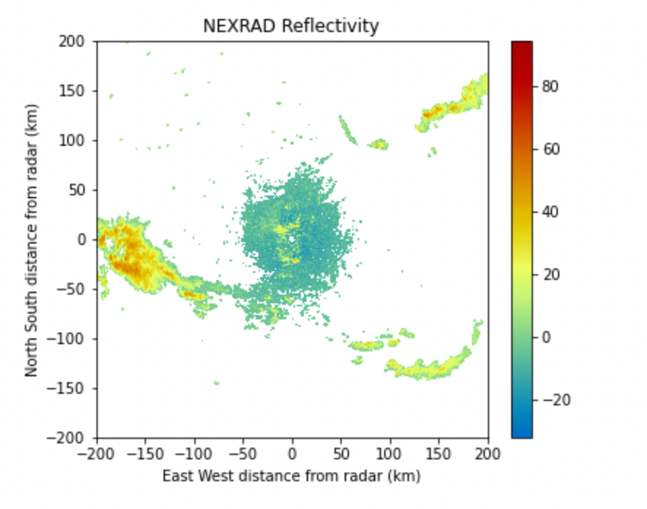
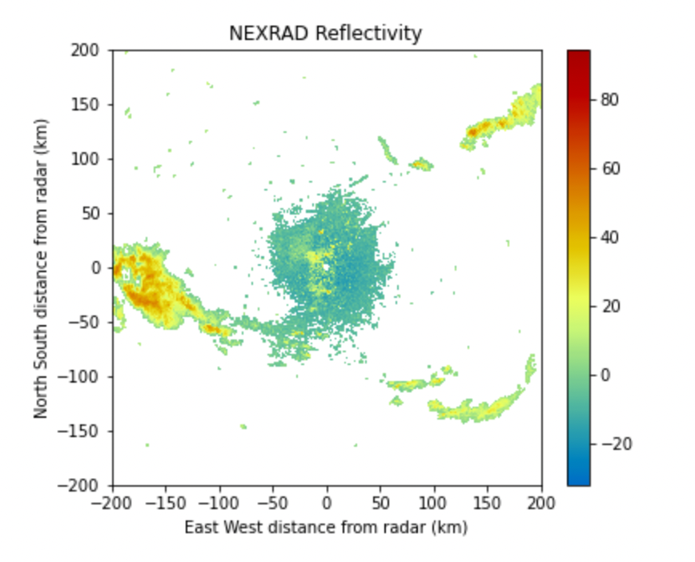
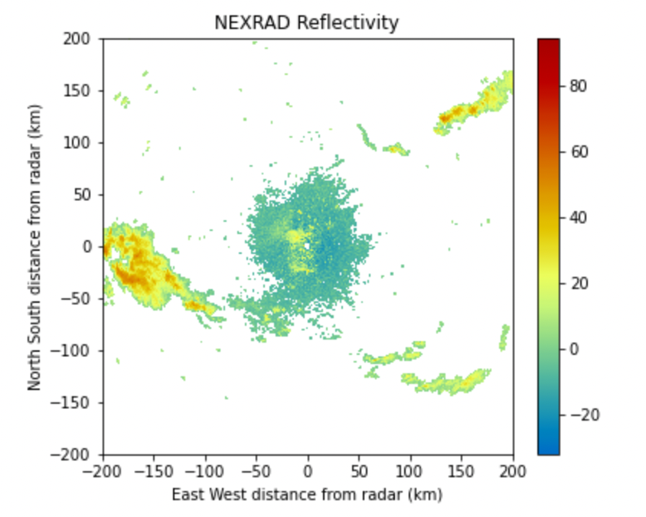
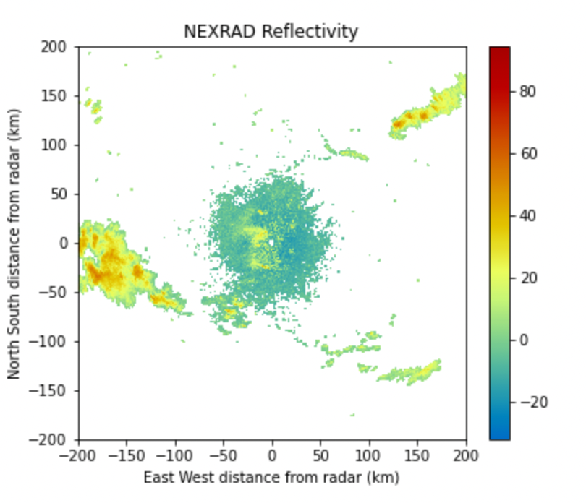
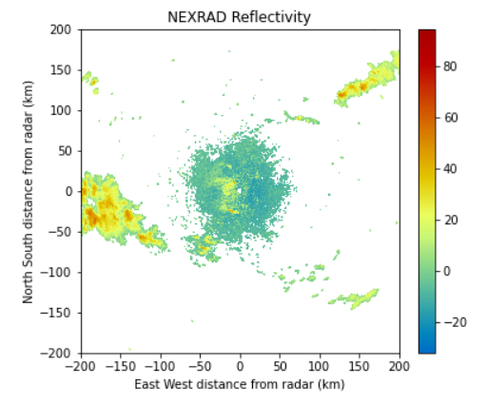
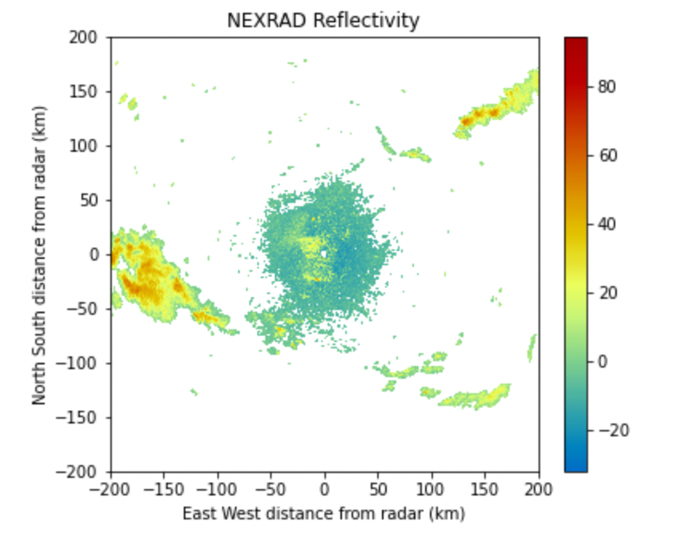
Radar Reflectivity Plots

Slide 9
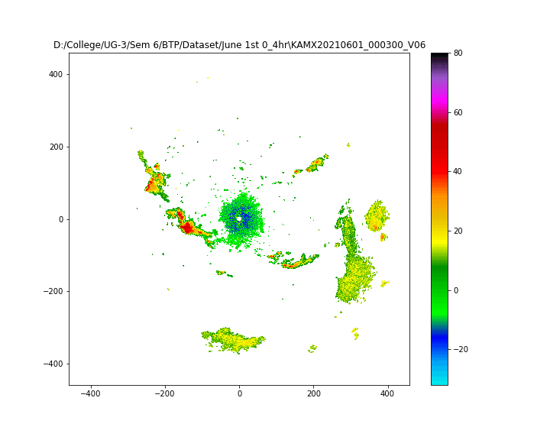
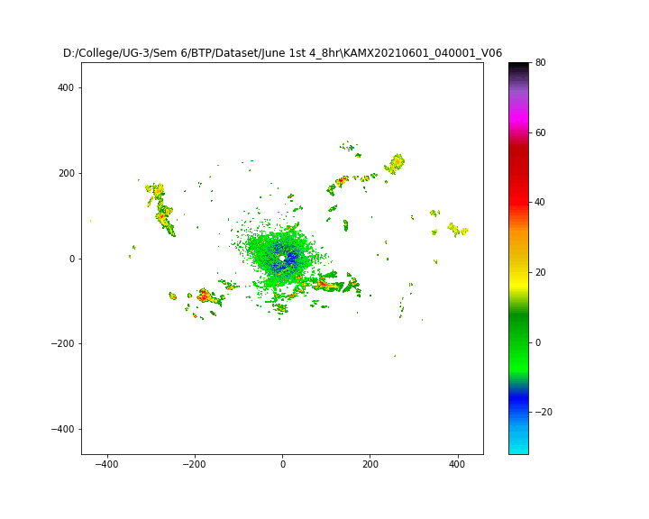
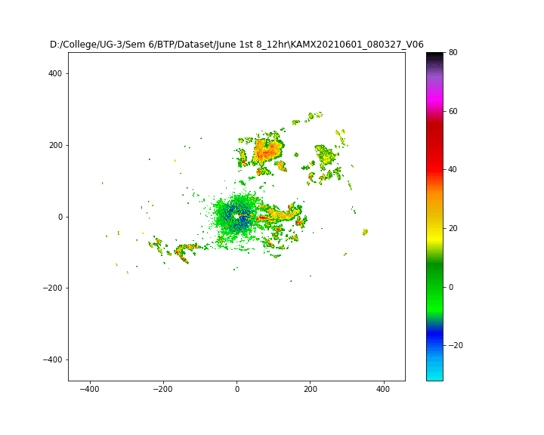
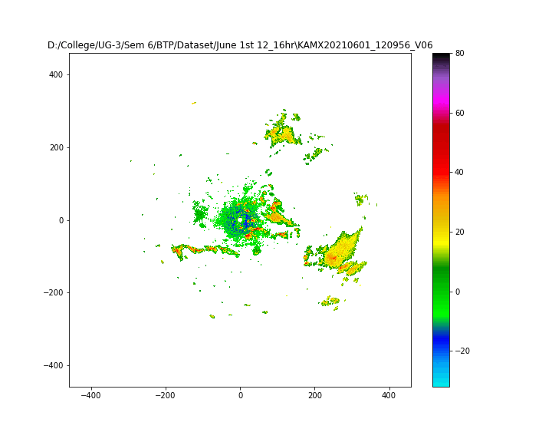
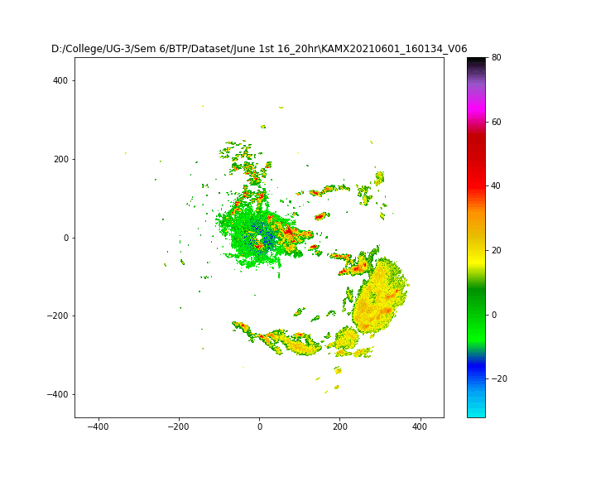
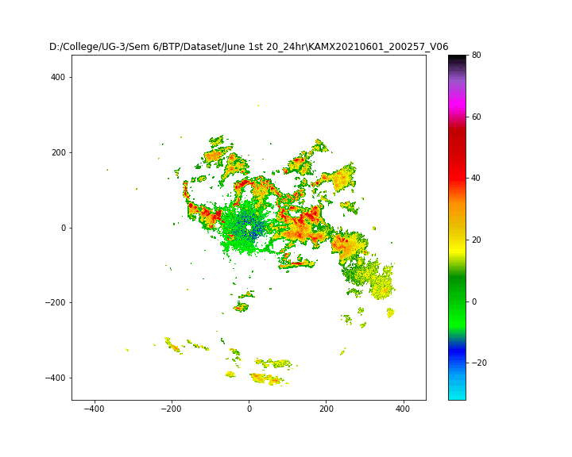
Dynamic Visualization
NOTE: View as slide show for the plots to move

Slide 10
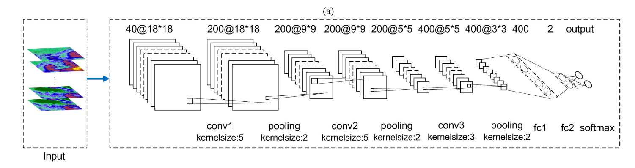
Block Diagram : (Base CNN)
Input
Data pre-processing
plotting
labelling
CNN
Convolution and pooling layers
Fully Connected layers
sigmoid
Output

Slide 11
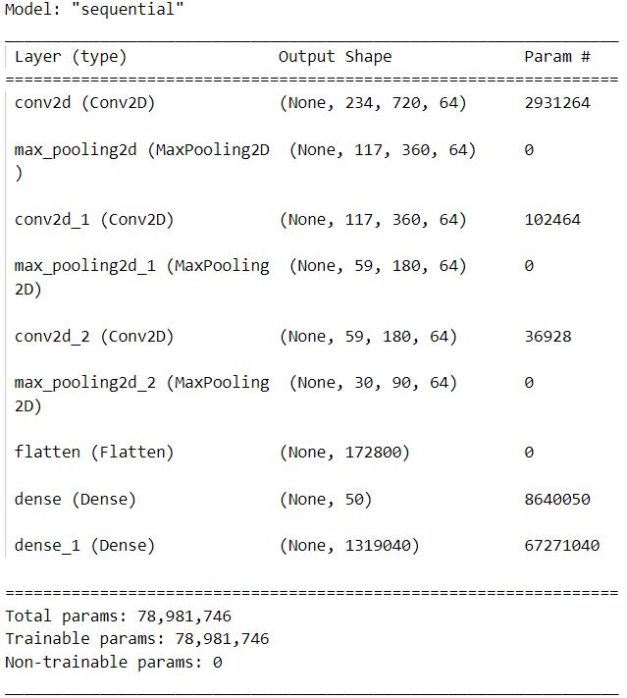
Model Summary - Base CNN
– Convolution Layer 1 with a Kernal Size of 5
– Pooling Layer 1 with a Kernal Size of 2
– Convolution Layer 2 with a Kernal Size of 5
– Pooling Layer 2 with a Kernal Size of 2
– Convolution Layer 3 with a Kernal Size of 3
– Pooling Layer 3 with a Kernal Size of 2
– Fully Connected (Dense) Layer 50 units
– Fully Connected (Dense) Layer with a output shape of 720x1832
Trained with 3 months of Miami (KAMX) data

Slide 12
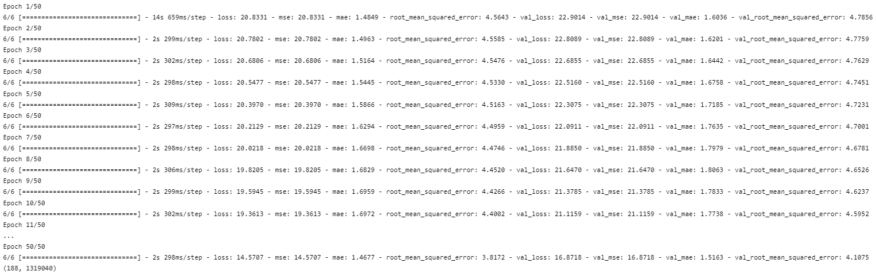
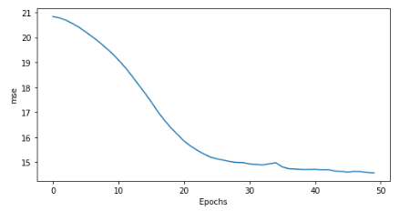
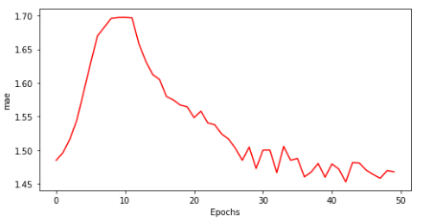
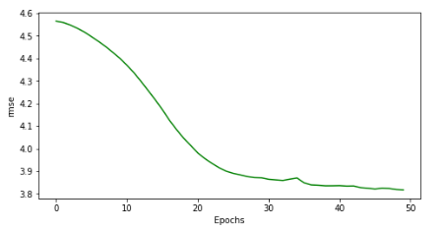
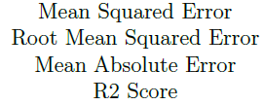
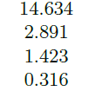
Results - Base CNN

Slide 13
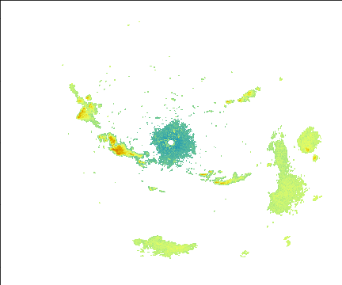
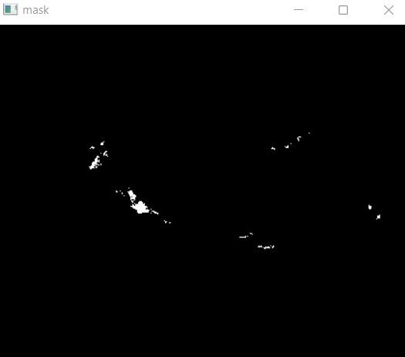
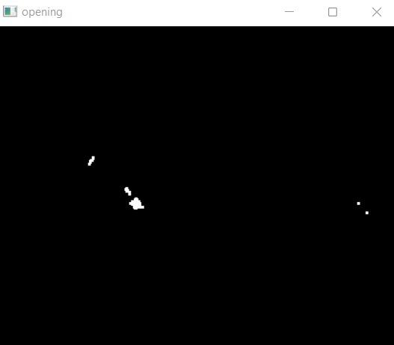
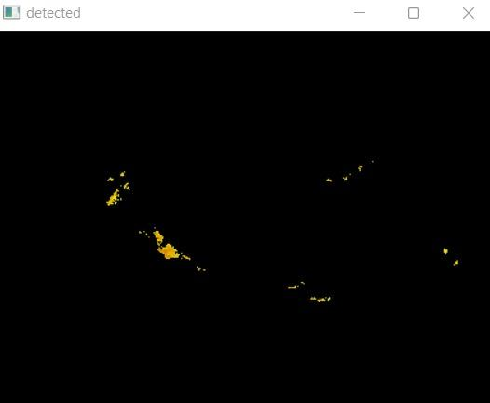
Rainfall detection over an area

Slide 14
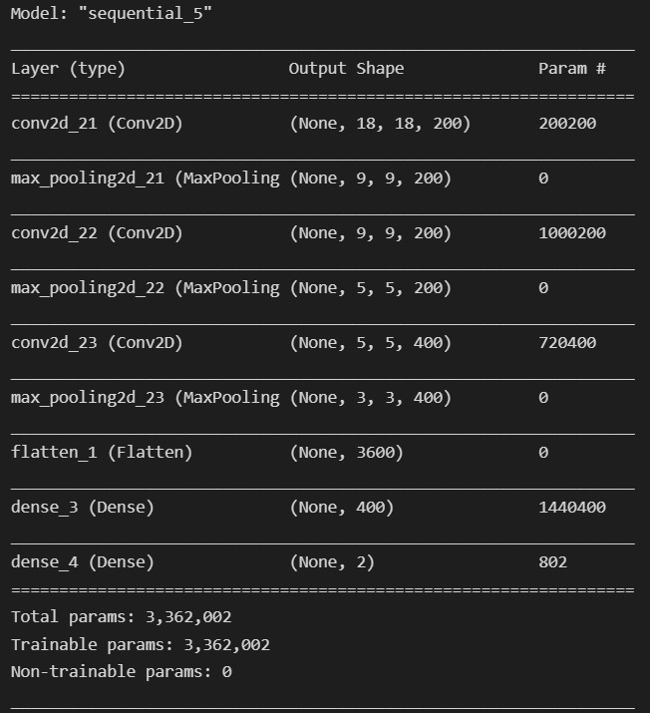
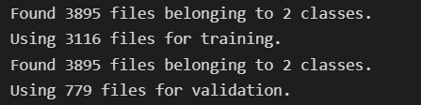
Model Summary: Classification
Splitting Training and Testing Data: 80%-20%
Classes:
Class 1 - Rainfall Across Large Area (>400 sqkm)
Class 2 - Rainfall Across Small Area (<400 sqkm)

Slide 15
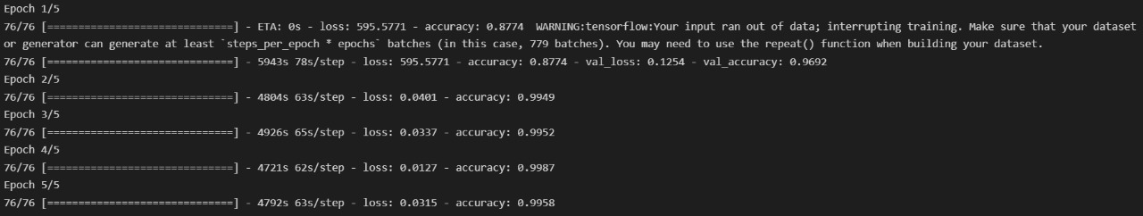
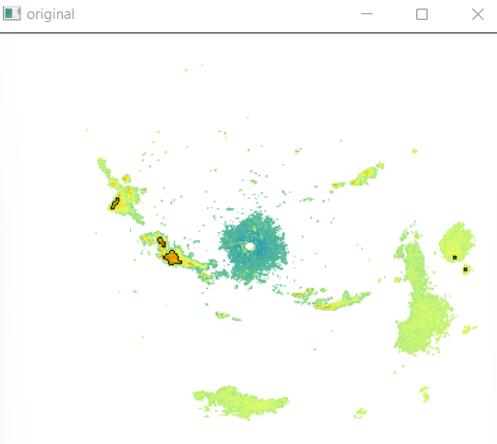
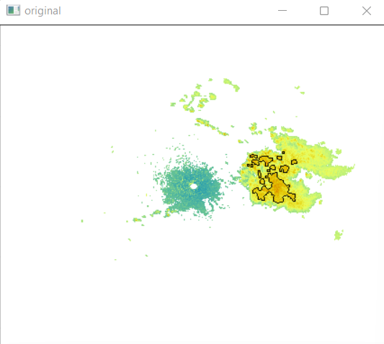
Classification Results
Small Area:
Large Area:

Slide 16
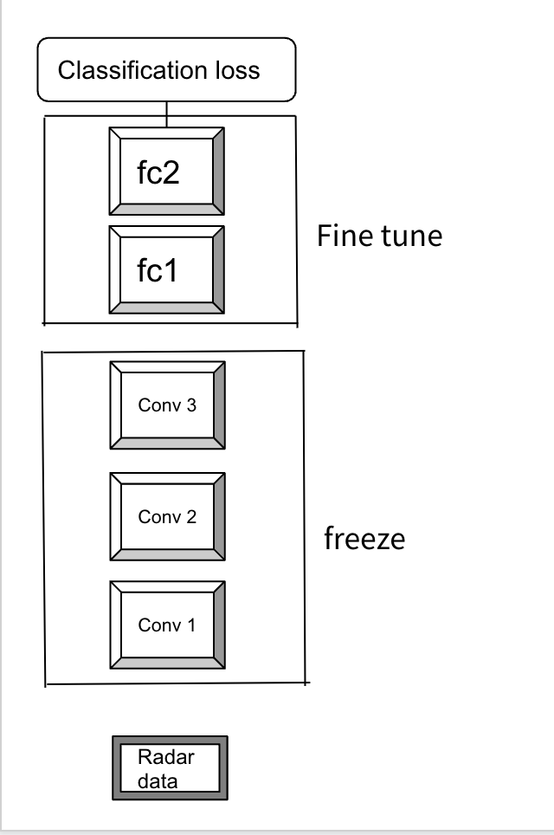
Block Diagram - CNN-FT

Slide 17
Model Summary - CNN-FT
– Convolution Layer 1 with a Kernal Size of 5
– Pooling Layer 1 with a Kernal Size of 2
– Convolution Layer 2 with a Kernal Size of 5
– Pooling Layer 2 with a Kernal Size of 2
– Convolution Layer 3 with a Kernal Size of 3
– Pooling Layer 3 with a Kernal Size of 2
– Fully Connected (Dense) Layer 50 units
– Fully Connected (Dense) Layer with a output shape of 720x1832
Trained with 1 week of New Orleans (KLIX) data after importing the trained weights of Base CNN

Slide 18
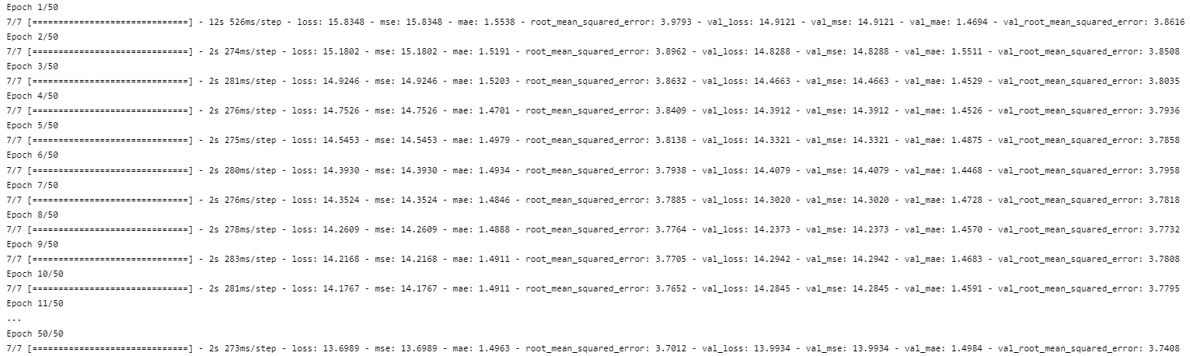
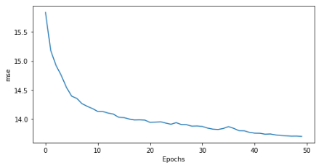
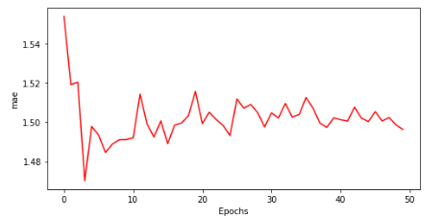
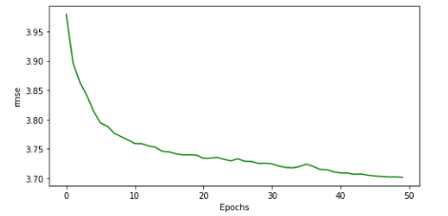
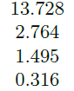
Results - CNN-FT

Slide 19
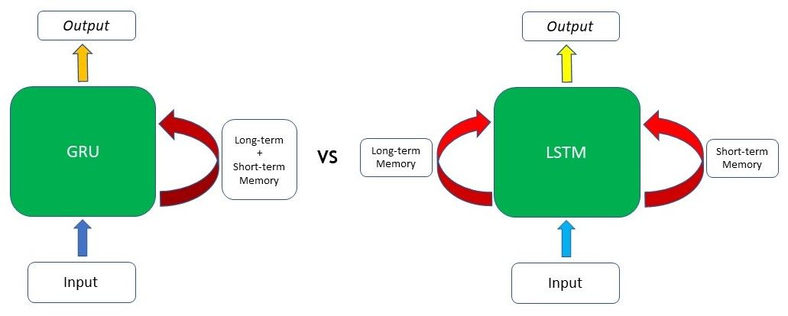
Gated Recurrent Unit - GRU
In sequence modeling techniques, the Gated Recurrent Unit is the newest entrant after RNN and LSTM, hence it offers an improvement over the other two.
GRU uses gates to control the flow of information.
There are Primarily 2 gates. The first gate is the Reset gate and the other one is the update gate.

Slide 20
Block Diagram - CNN-GRU
GRU

Slide 21
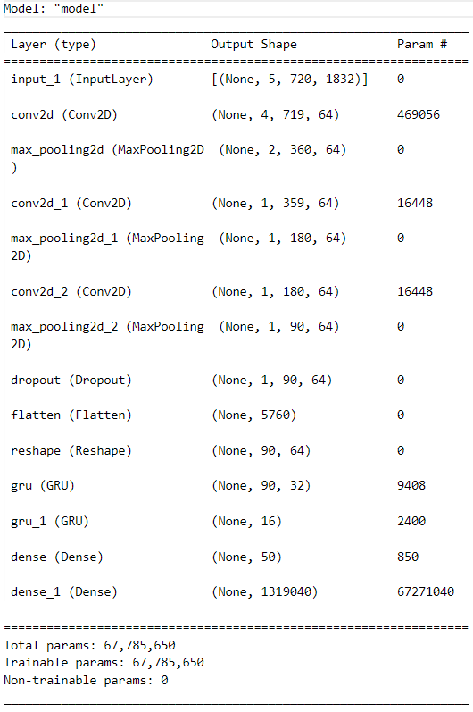
Model Summary - CNN-GRU
The GRU Layers are added after flattening the outputs from the Convolution and Pooling Layers.
The 1st GRU layer is implemented with a units count of 32, activation function as tanh (default) and recurrent activation function as sigmoid (default)
followed by a 2nd GRU layer with a units count of 16, activation function as relu and recurrent activation function as sigmoid (default).
The GRU output is then passed to a Fully Connected (Dense) Layer followed by another Fully Connected
Layer which is reshaped to generate the forecast output.

Slide 22
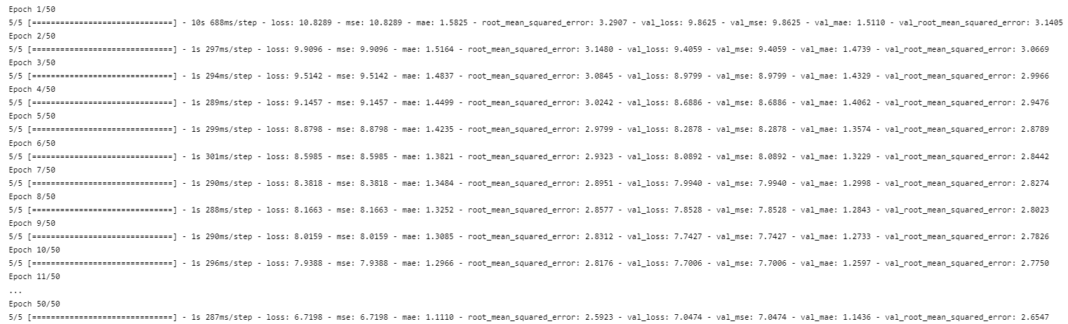
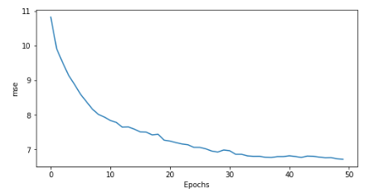
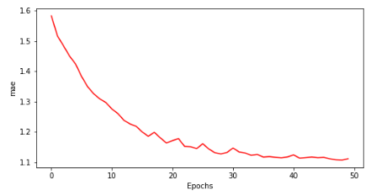
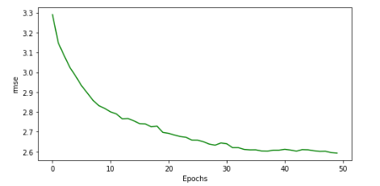
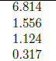
Results - CNN-GRU

Slide 23
Evaluation Timeline:
1
Sem 6 Mid
3
Sem 7 Mid
Understanding the Problem statement, Collection of dataset and Visualising the Dataset from ar2v format.
A demonstration of the base CNN model trained with 3 months of data and saved parameter for transfer learning and classification result. (supplement)
6
2
Sem 6 End
4
Sem 7 End
A demonstration of the base CNN model with small amount of data and performance analysis of the model
Final demonstration of CNN -FT, CNN-GRU and comparative analysis
Documentation of the project

Slide 24
References
https://ieeexplore.ieee.org/document/9354430
https://ieeexplore.ieee.org/document/8897082
https://arxiv.org/abs/1411.1792
Thank you

